Slide 1
POE inference

Slide 2
Data Generation

Slide 3
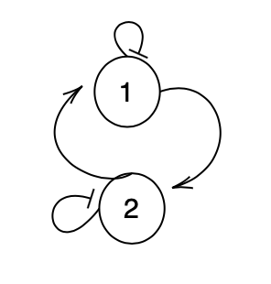
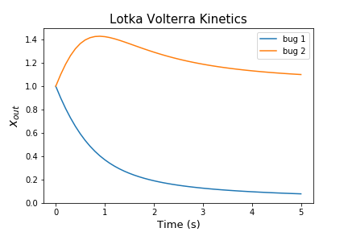
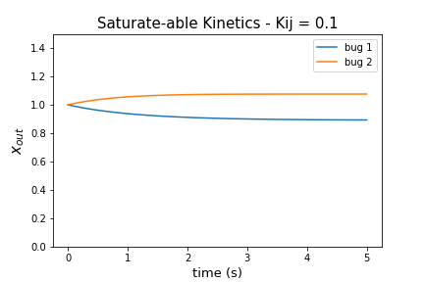
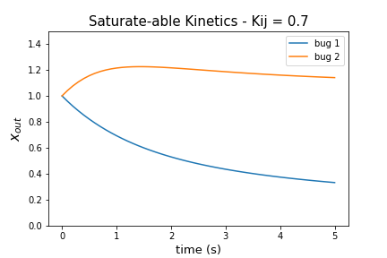
2 Microbes Competing
Notes:
Fix to negative!

Slide 4
2 Microbes Competing

Slide 5
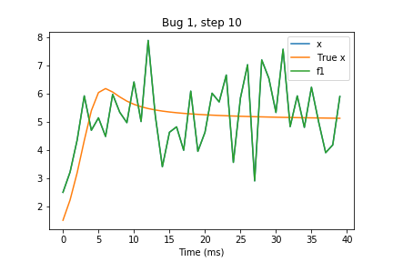
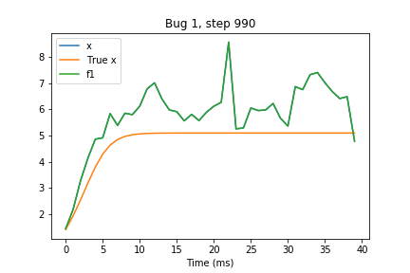
Direct LV Inference (i.e. no spline)
Notes:
Plot noise

Slide 6
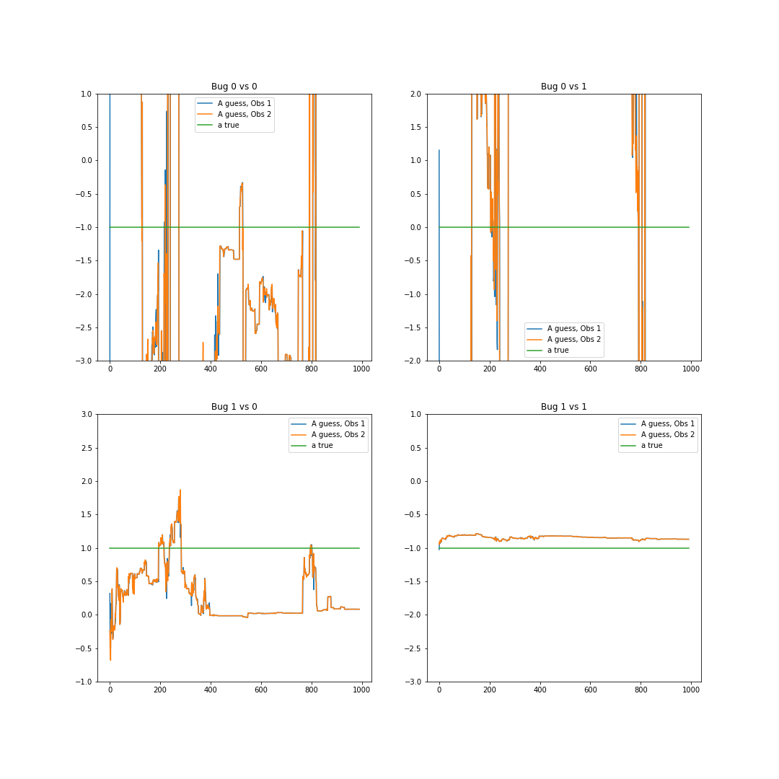
A and B over time

Slide 7
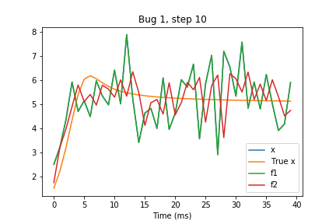
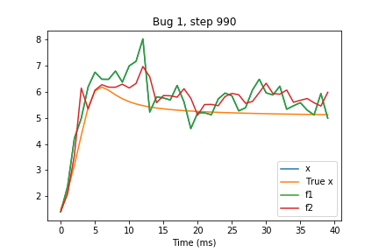
Functional Regularized F1 Inference

Slide 8
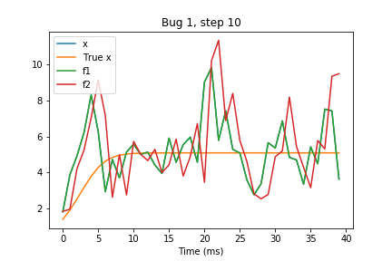
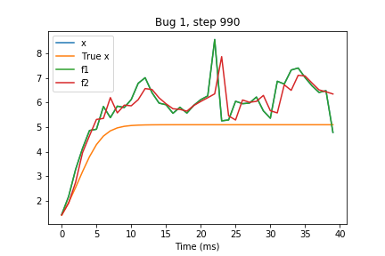
Functional Regularized Saturable Inference

Slide 9
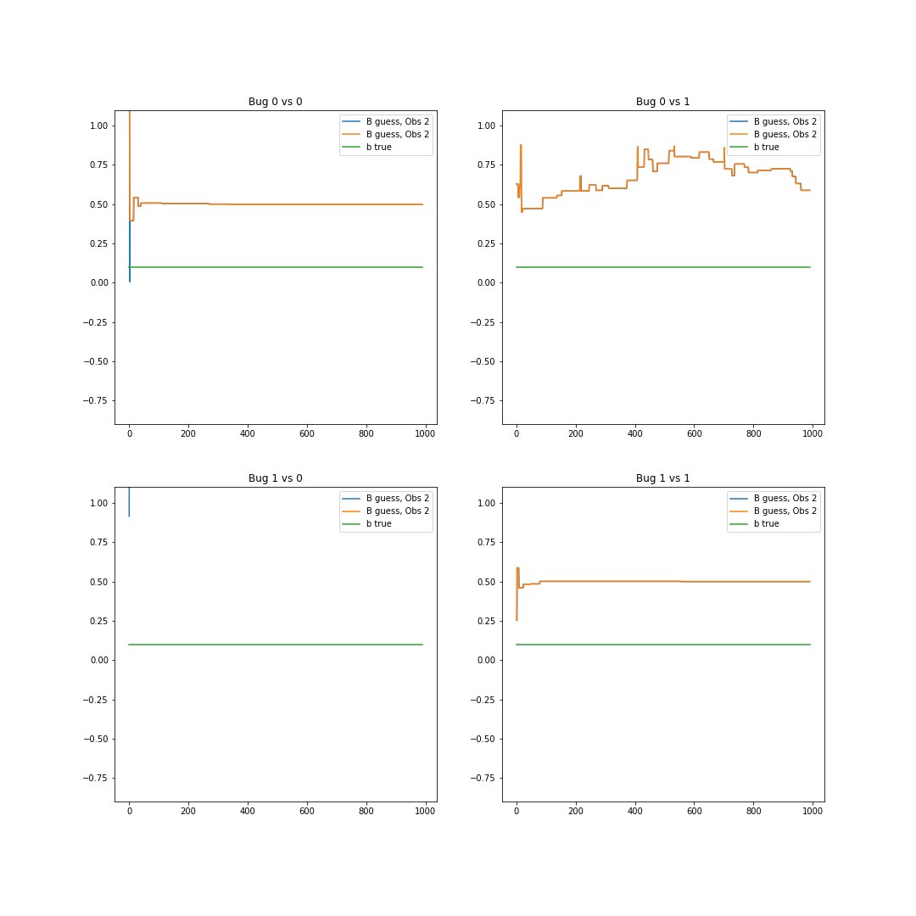
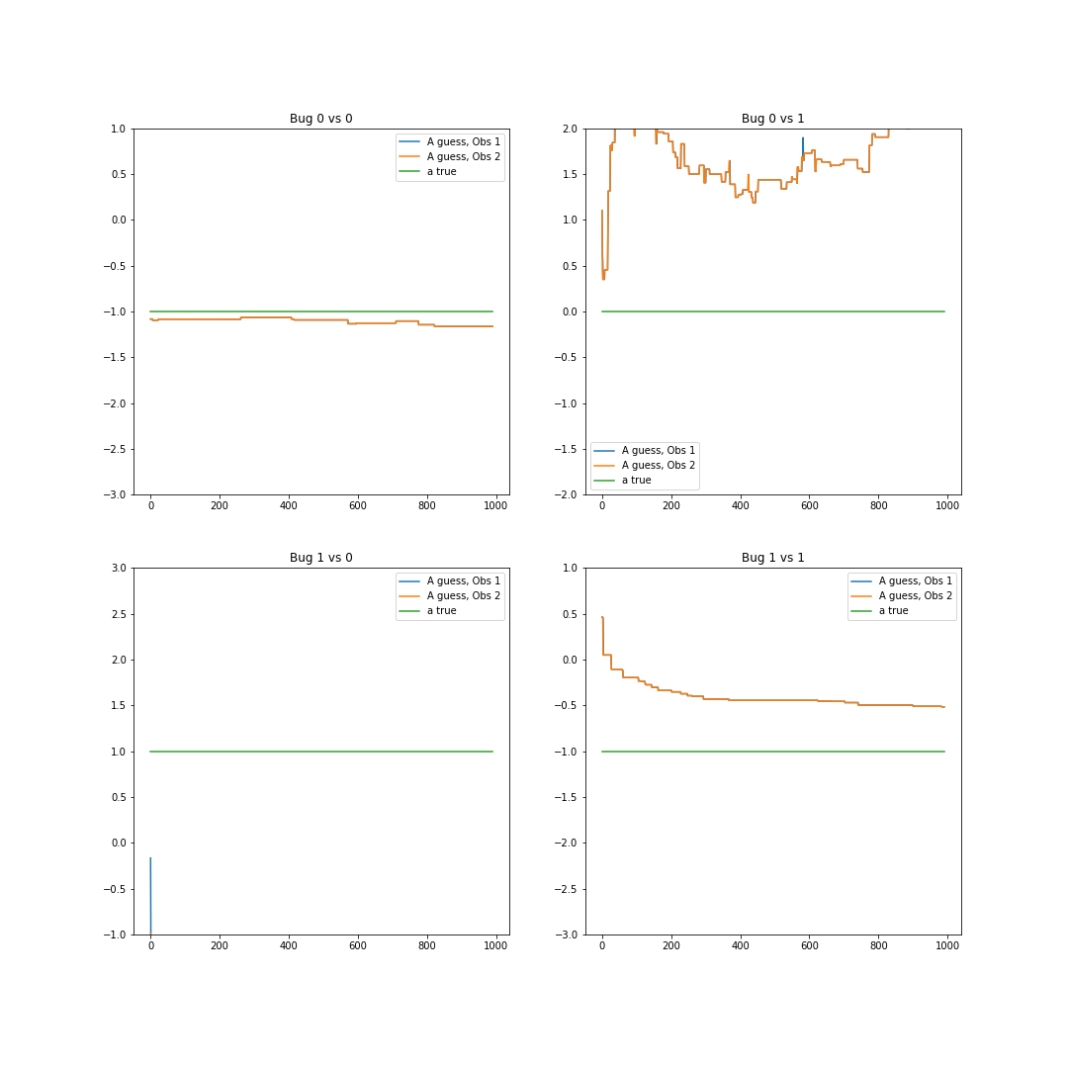
A and B over time – not great

Slide 10
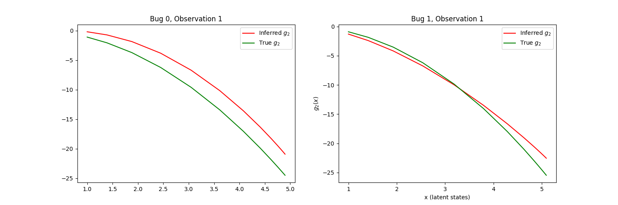
But f_{2} doesn’t look too far off of what it’s supposed to

Slide 11
Comparing Conditions

Slide 12
Gifs

Slide 13
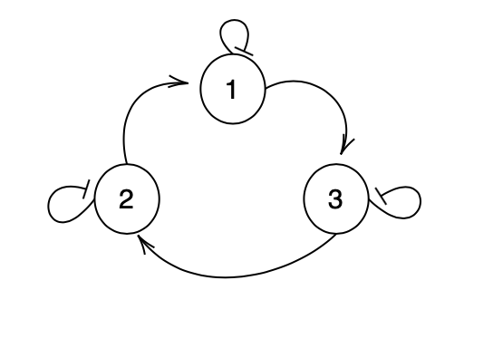
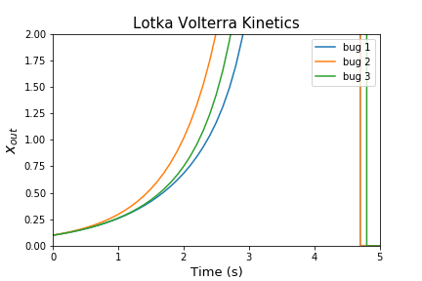
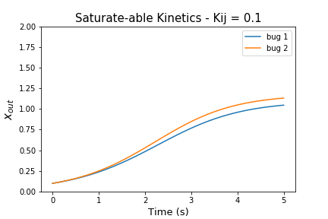
3 Microbes Cooperting

Slide 14
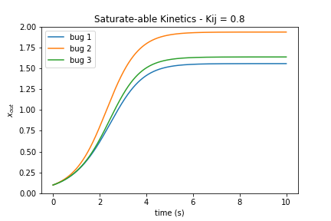
3 Microbes Cooperting

Slide 15
Direct LV inference

